Slide 1
Automatic Invoice Generator using Python
BY
Akash Harsha S AP23110011490
Devi Sree H AP23110011510

Slide 2
Introduction
This project focuses on building an automated system to generate professional invoice PDFs using Python.
It helps small businesses and freelancers avoid manual billing and save time.
The system reads invoice data from structured files and generates clean, GST-style invoices like Amazon.

Slide 3
Problem Statement
01
02
03
Manual invoice generation is time-consuming
and error-prone
Small retailers may not have access to costly billing software.
Our goal: Build a simple, reliable, and customizable invoice generator using Python.
—

Slide 4

Tools & Technology
We built this project using Python as the main language. The invoice details are stored in a CSV file, and we used the FPDF library to convert that data into a clean, professional PDF. To make it easier to input data, we added a simple GUI using Tkinter. We also included features like automatic tax calculation (CGST & SGST), discount handling, and a custom template that makes the invoice look just like an Amazon bill. Everything works together smoothly to generate a ready-to-send invoice in just one click.

Slide 5
OUR GOALS
Short term
Long term
Build a working invoice generator using Python
Create a user-friendly form to input invoice data
Generate professional PDF invoices automatically
Add database integration for storing past invoices
Include email functionality to send invoices directly
Make the tool scalable for use by small businesses

Slide 6
Features
Invoice Input Made Easy
Professional Invoice Output
User-friendly GUI form to enter client and item details, which are stored in a CSV file automatically.
Generates polished PDF invoices using a template similar to Amazon’s, with logo, table, and legal disclaimer.
Smart Billing & Calculations
Automatically applies quantity, discounts, tax (CGST + SGST), and calculates grand total.

Slide 7
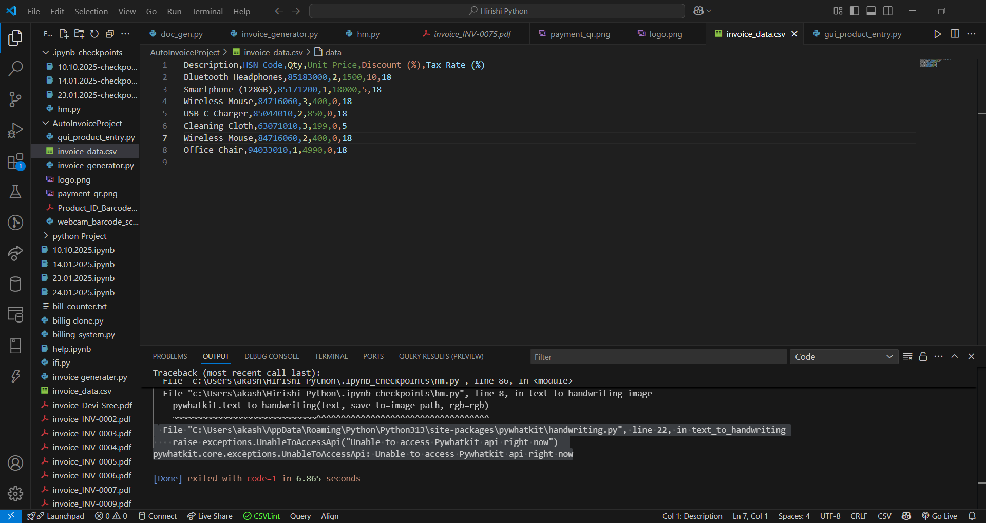
Screenshots
GUI
CSV input
Click Here For GUI
Sample Invoice PDF
invoice_INV-0002.pdf

Slide 8
Output
A professional invoice in PDF format
Includes:
Item description, HSN, Qty, Discount, Tax
GST split and grand total
Buyer & Seller details
Footer disclaimer
File is ready for download, email, or print

Slide 9
Conclusion
Project demonstrates how Python can simplify real-world business processes
We successfully automated invoice generation with customization
Easy to integrate into any small business setup

Slide 10
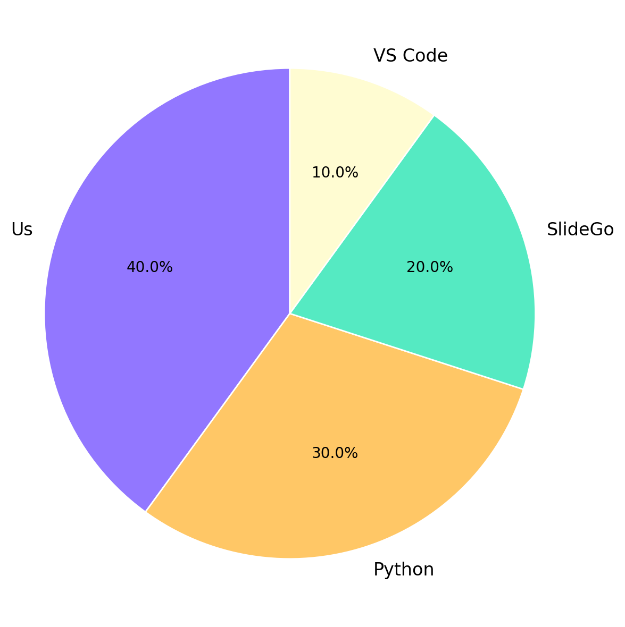
References
These references helped guide our logic, layout structure, and technical implementation throughout the project.”

Slide 11

Scan Me
By Hirishi & Honne
THANK YOU

